Slide 1
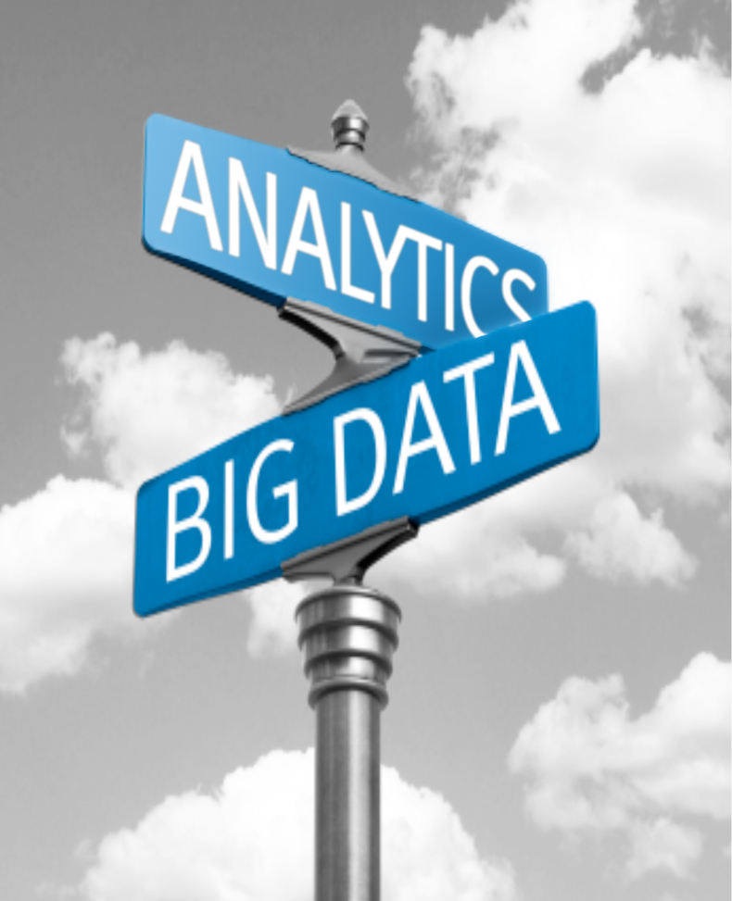
It’s An Exciting Time In
The Industry
Bill Schmarzo
CTO, EIM&A Practice
EMC Consulting
  Email: William.Schmarzo@emc.com
  LinkedIn: http://www.linkedin.com/in/schmarzo
  Twitter: @schmarzo
  Blog: http://infocus.emc.com/author/william_schmarzo/
Notes:
Hello, my name is Bill Schmarzo and I am the CTO within EMC Consulting
I get to spend my days working with clients helping them to identify where and how big data can impact their key business initiatives
Let me share some observations about how we’re seeing big data impact the healthcare industry

Slide 2

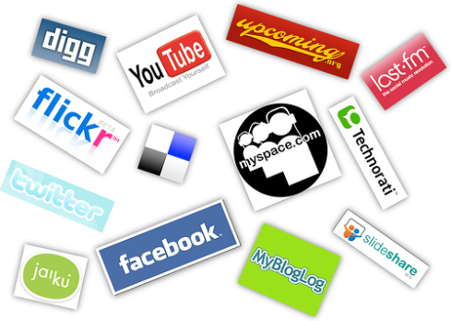
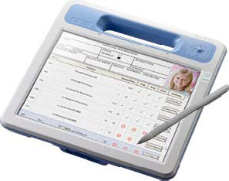
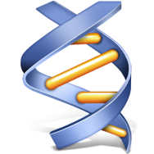
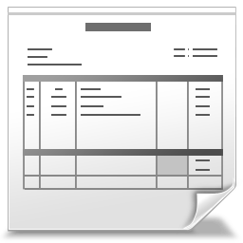
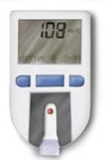

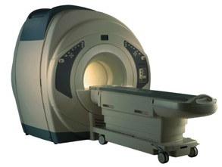
New Health Sciences Data Sources
Drug Research
Social Media
Patient Records
Gene Sequencing
Test Results
Claims
Home Monitoring
Mobile Apps
Notes:
First, massive amounts of structured and unstructured data – both within and outside the organization – that can yield new insights on patients, treatments, research and the healthcare payer-provider system
As well as high-velocity / low-latency data (referred to as “big fast data”) that can accelerate our ability to identify, understand and act upon those patient, treatment and healthcare insights
And even more data sources are on their way in areas such as:
Genomics
Electronic patient records
Mobile apps
Connected home health monitoring devices

Slide 3
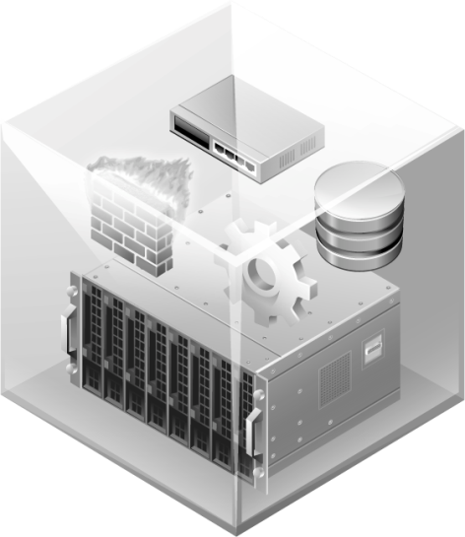
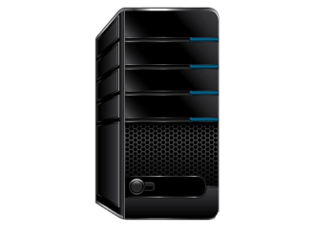

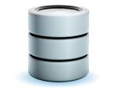
New Big And Fast Data Technologies
MASSIVELY PARALLEL DATABASE
MPP Architectures
In-Memory And Data Virtualization
In-Database Analytics
Notes:
Second, new big and fast data technologies are emerging to exploit these new data sources, including:
MPP, scale out architectures – both relational databases and Hadoop – to manage the wealth of structured and unstructured data
In-memory Computing to identify and act upon the patient, treatment and healthcare industry insights more quickly
Data Virtualization to provide access to all the available data, wherever it may be located, without that data having to be centralized in one massive data warehouse, and
In-database Analytics to accelerate the development, refinement and operationalization of predictive analytics

Slide 4
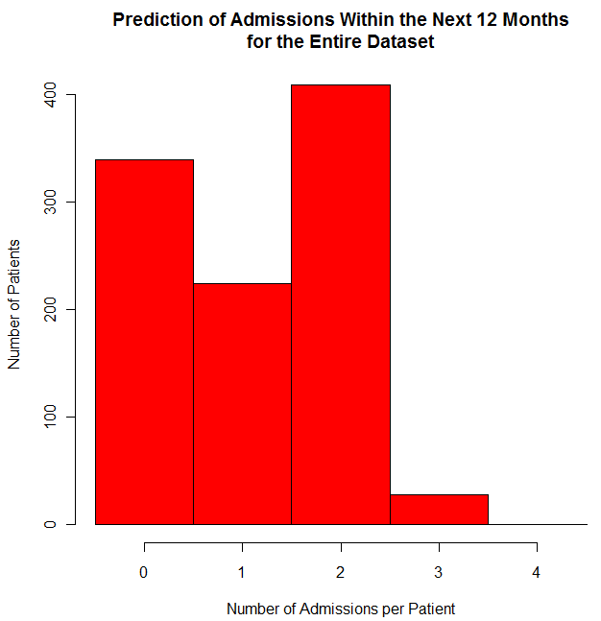
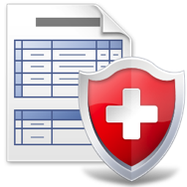

Health Sciences Industry Transformation
1
2
3
Detecting Fraud In Real-time
Reducing
Readmissions
Improving
Patient Care
Notes:
Industry-transformational use cases are starting to merge including:
Detecting fraud in real-time
By using Hadoop to match historical claims and payment data, with…
…in-memory computing to analyze current transactions to flag potential fraudulent activities
Reducing hospital readmissions
By using MPP databases and data virtualization to integrate past admissions, outcomes and current patient data, with…
…in-database analytics to create re-admission scores at patient check-in
Improving patient care
By using Hadoop and data virtualization to integrate all treatment, patient history, and even DNA data, with…
…advanced analytics to attribute the effectiveness of different medications, treatments and lifestyle changes upon a patient’s health

Slide 5
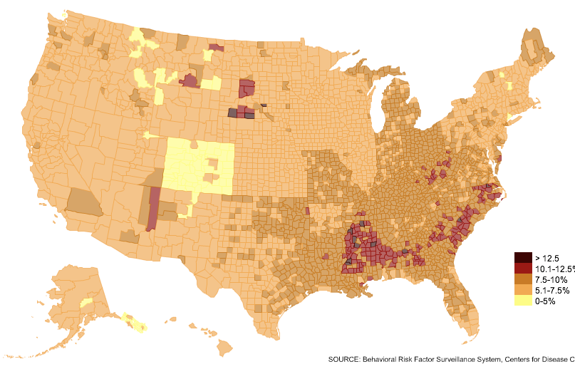
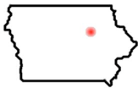

Aggregate And Mine Data For New Insights
THE SPREAD OF
DIABETES
ACROSS THE US
Notes:
And huge opportunities exist to “pool” patient, treatment and healthcare data to:
pre-empt disease breakouts,
share best practices
encourage analytics collaboration in order to…
improve individual patient care while reducing the overall cost of care
There is why McKinsey estimated a staggering $200 billion savings on national healthcare spending through the application of big data capabilities

Slide 6
Thank You! Learn More Here
Booth 203
Tuesday, 3:35 pm Yosemite C | Big Fast Data in Health Sciences: A Panel of Experts Discusses What and Why
Wednesday, 2:05 pm Yosemite C | A Predictive Approach to Real-Time Detection of Fraud, Waste, and Abuse in Healthcare
Notes:
To learn more about what we at EMC, Greenplum and VMWare are doing to leverage big data and advanced analytics to impact the healthcare industry, please visit us at one of these sessions.
And stop by booth 203 in the exhibits
Thank you!

